Slide 1
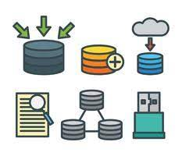

Introduction to DBMS & The E-r model
Courtesy:
Ramakrishnan and Gehrke
Silberschatz, Korth and Sudarshan
Yong Choi, CSUB
Kabindra Koirala
Anjali Jivani
Notes:
1

Slide 2
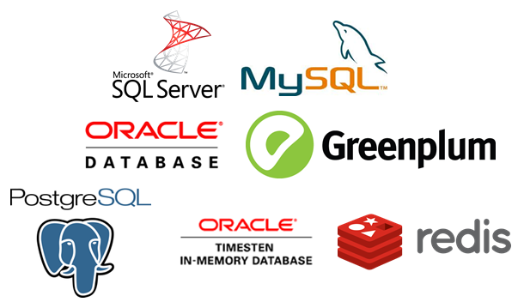
What is a database?
A database is an organized collection of structured information, or data, typically stored electronically in a computer system. A database is usually controlled by a database management system (DBMS).
Together, the data and the DBMS, along with the applications that are associated with them, are referred to as a database system, often shortened to just database.
Data within the most common types of databases in operation today is typically modelled in rows and columns in a series of tables to make processing and data querying efficient.
The data can then be easily accessed, managed, modified, updated, controlled, and organized.
Most databases use structured query language (SQL) for writing and querying data.

Slide 3
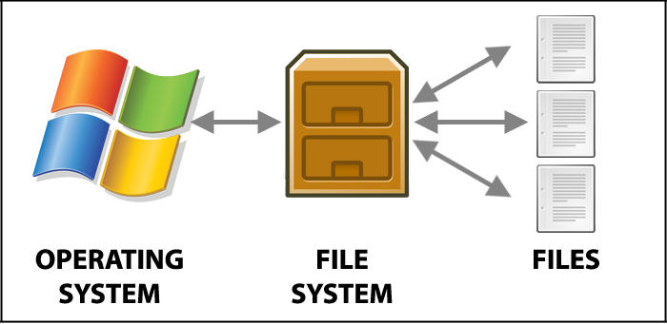
the file systems
Drawbacks of the File System:
Data redundancy and inconsistency
Multiple file formats, duplication of information in different files
Difficulty in accessing data
Need to write a new program to carry out each new task
Data isolation
Multiple files and formats
Integrity problems
Integrity constraints (e.g., account balance > 0) become “buried” in program code rather than being stated explicitly
Hard to add new constraints or change existing ones

Slide 4

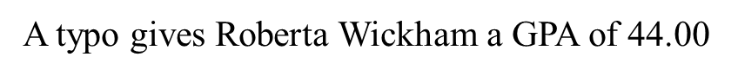
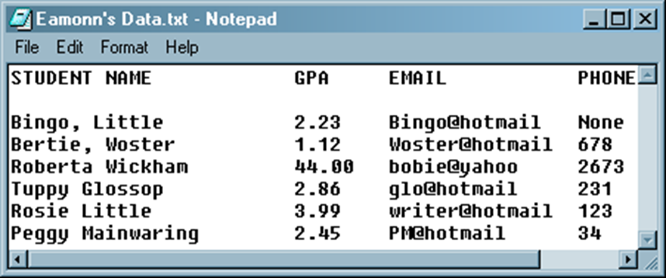
Enforcing Constraints
A DBMS allows us to enforce all kinds of constraints. This really helps (but does not guarantee) that our data is correct.

Slide 5
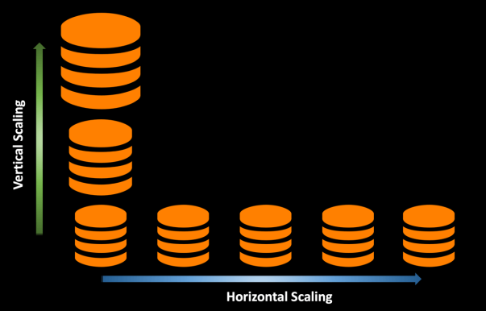
Scalability
Most real world datasets are so large that we can only have a small fraction of them in main memory at any time, the rest has to stay on disk.
Database scalability is the ability to scale out or scale up a database to allow it to hold increasing amounts of data without sacrificing performance.
Scaling out often involves moving the database across multiple database servers in a distributed cluster while scaling up involves increasing the computing power and resources of the database server.
Notes:
Scaling out = adding more components in parallel to spread out a load. Scaling up = making a component bigger or faster so that it can handle more load.

Slide 6

Query Expressiveness
Can execute complex queries which would not be possible with a flat file.
Can write some program that might allow more expressive queries on the text file, but it would be tied into the structure of the data and the operating system etc..
With a DBMS we are completely isolated from the physical structure of our data. If we change the structure of our data (by adding a field, for example) or moving from a PC to a Mac, nothing changes at the front end!
Notes:
1960s:
Data collection, file processing, paper documentation
1970s:
Network DB, SQL, Relational data model, relational DBMS implementation
1980s:
RDBMS, advanced data models (extended-relational, OO, deductive, etc.)
Application-oriented DBMS (spatial, scientific, engineering, etc.)
Late 1980s and 1990s:
Data mining, data warehousing, multimedia databases, and Web databases
2000s
Stream data management and mining
Data mining and its applications
Web technology (XML, data integration) and global information systems

Slide 7

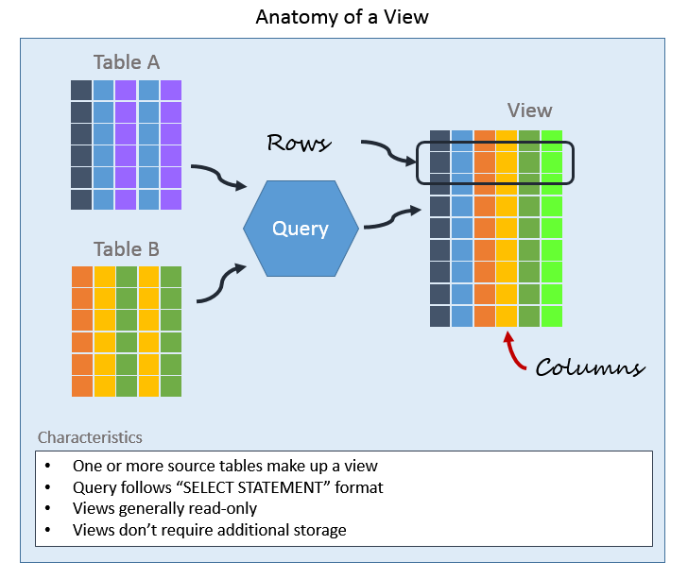
Different Views of Data
With a DBMS we can arrange for different people to have different views of the data. For example, I can see everything, a student can see only his/her data, the clerk can see…

Slide 8
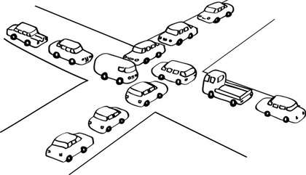
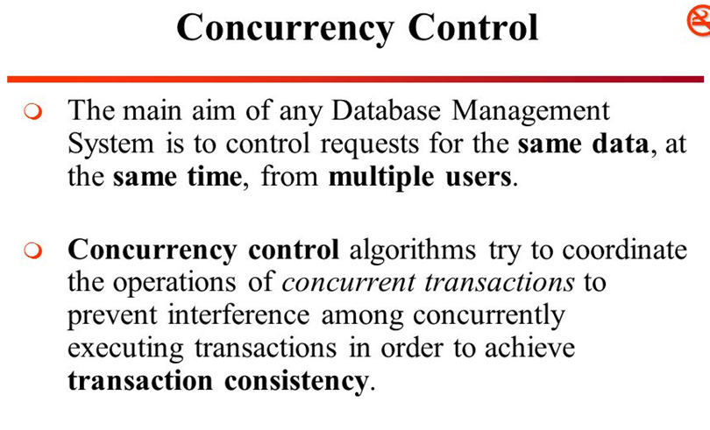
concurrency
Two people trying to modify the same data at the same time!
A DBMS will automatically make sure that this kind of thing cannot happen.

Slide 9

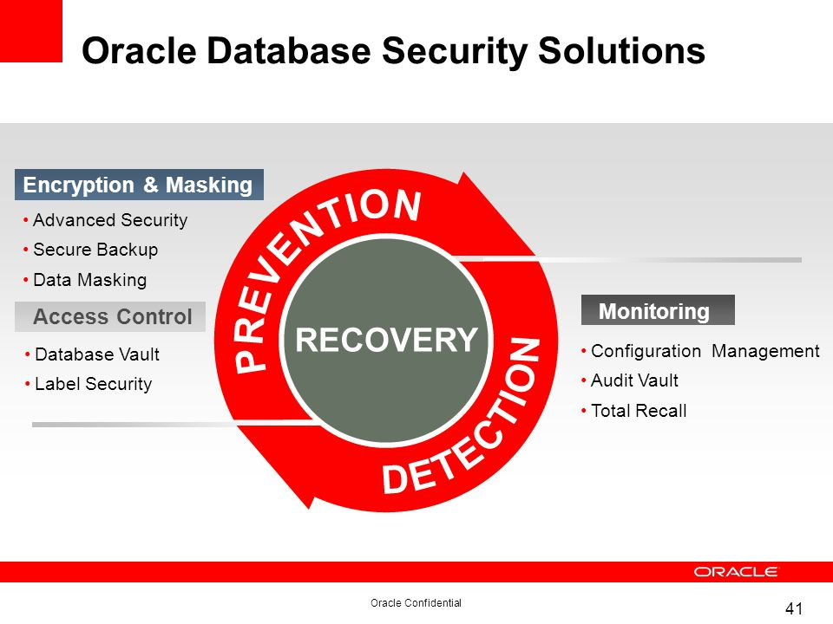
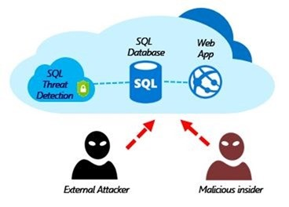
security
Suppose I leave my text file in my user account, and a student hacks in and changes their grades…
A DBMS will allow multiple levels of security.
Notes:
SQL Injection
SQL injection is a code injection technique that might destroy your database.
SQL injection is one of the most common web hacking techniques.
SQL injection is the placement of malicious code in SQL statements, via web page input.
SQL injection usually occurs when you ask a user for input, like their username/userid, and instead of a name/id, the user gives you an SQL statement that you will unknowingly run on your database.
Look at the following example which creates a SELECT statement by adding a variable (txtUserId) to a select string. The variable is fetched from user input (getRequestString):
txtUserId = getRequestString("UserId"); txtSQL = "SELECT * FROM Users WHERE UserId = " + txtUserId;

Slide 10

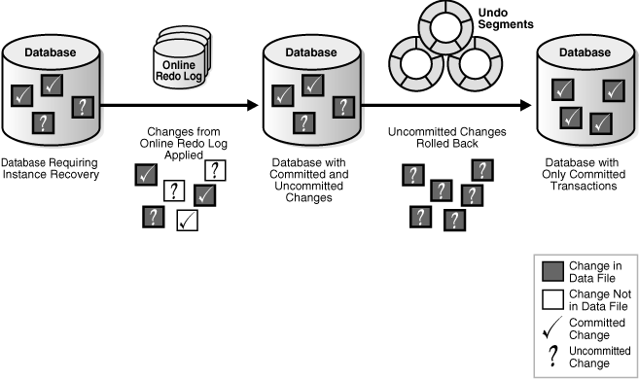
Crash recovery
Suppose you are editing a text file and the system crashes!
A DBMS is able to guarantee 100% recovery from system crashes.
Crash recovery is the process by which the database is moved back to a consistent and usable state.
This is done by rolling back incomplete transactions and completing committed transactions that were still in memory when the crash occurred
Notes:
Crash Recovery, Instance Recovery, Media Recovery for an Oracle database
Here is the big picture of the Crash Recovery, Instance Recovery, Media Recovery and Block Media Recovery for an Oracle database :
---------------------------------------------- --- crash recovery & instance recovery ---> no ARC log needed ---------------------------------------------- crash recovery = failure either when a single-instance database fails or all instances of an Oracle RAC database fail. instance recovery = on RAC when 1 or more instances are still up and working. For crash recovery & instance recovery there is the same recovery mechanism: 1. cache recovery (rolling forward) -> all the redo log from the last CKPT (committed + uncommitted data) 1. transaction recovery (rolling back) -> uncommitted transactions are rolled back. ------------------------------------------------ --- media recovery & block media recovery ---> ARC log needed ------------------------------------------------ The same cache recovery + transaction recovery mechanism. media recovery = Needed when a disk failure occurred (many blocks must be recovered) block media recovery = Needed when a disk failure occurred (not many blocks must be recovered)

Slide 11
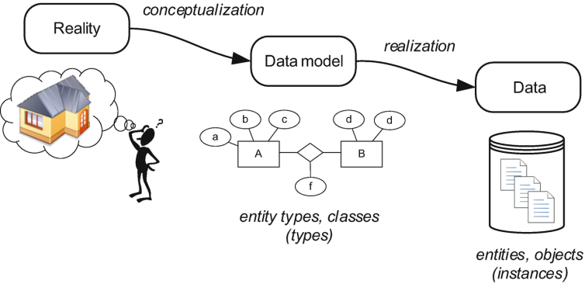
Data models
What is Data Modelling?
Data modelling is the process of creating a data model for the data to be stored in a database. This data model is a conceptual representation of Data objects, the associations between different data objects, and the rules.
Data modelling helps in the visual representation of data and enforces business rules, regulatory compliances, and government policies on the data.
Data Models ensure consistency in naming conventions, default values, semantics, security while ensuring quality of the data.
Data Model is a diagram that displays a set of tables and the relationships between them.
Notes:
Like an architect drawing the schematic designs of houses

Slide 12
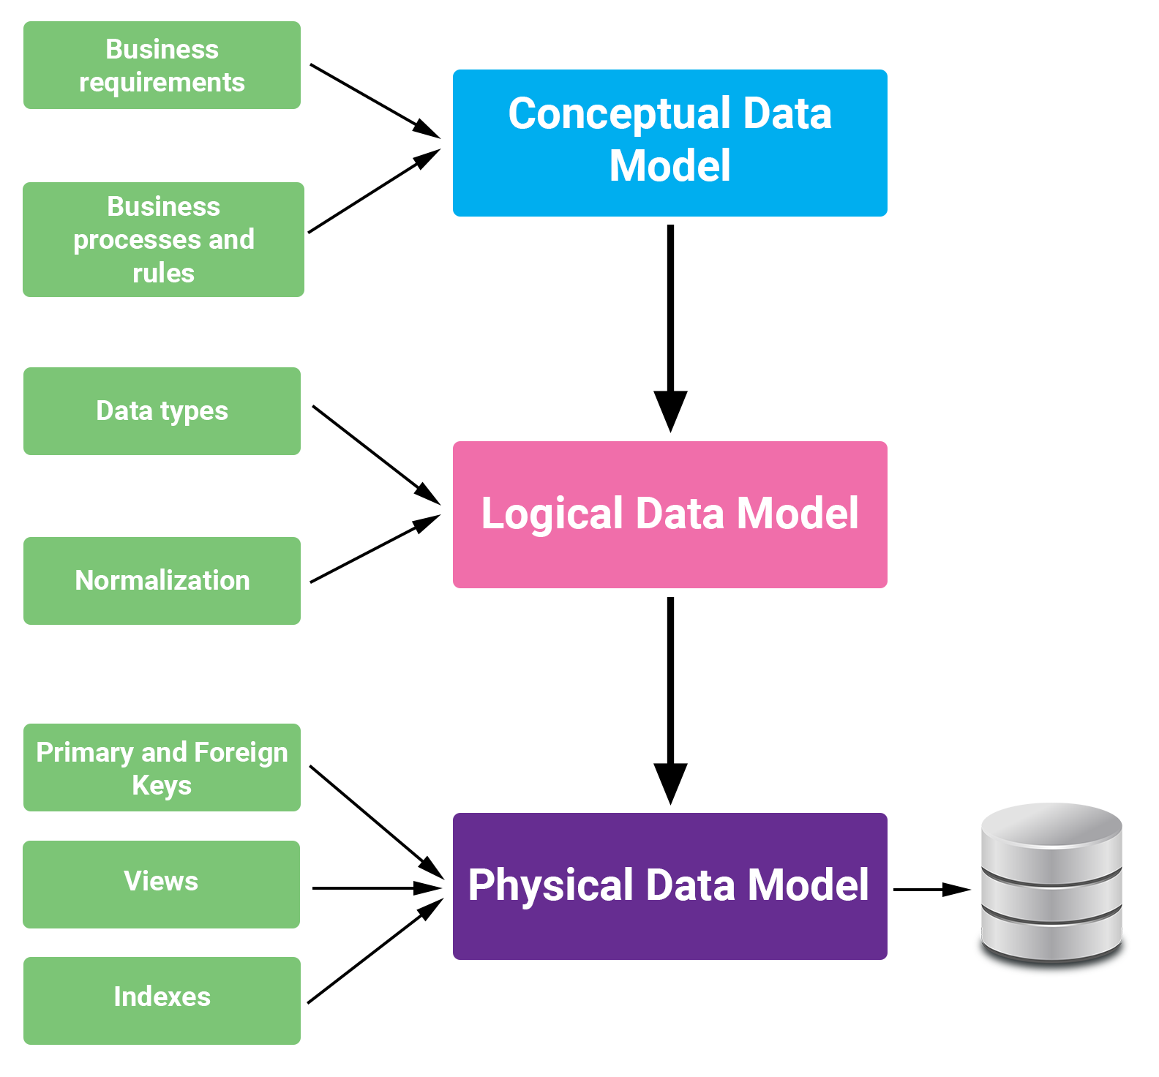
Notes:
A conceptual data model is the highest level, and therefore the least detailed. A logical data model involves more detailed thinking about the implementation without actually implementing anything. Finally, the physical data model draws on the requirements from the logical data model to create a real database.
Physical data models are used to visualize the physical structure of databases and data files. Logical data models are used to visualize data entities, attributes, keys, and relationships.

Slide 13
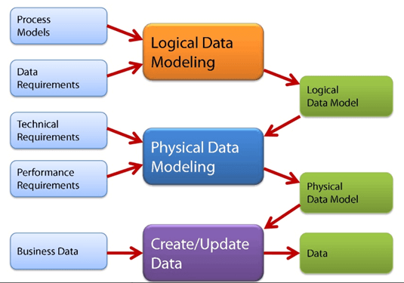
Data Models
Conceptual Data Model: This Data Model defines WHAT the system contains. This model is typically created by Business stakeholders and Data Architects. The purpose is to organize, scope and define business concepts and rules.
Logical Data Model: Defines HOW the system should be implemented regardless of the DBMS. This model is typically created by Data Architects and Business Analysts. The purpose is to developed technical map of rules and data structures.
Physical Data Model: This Data Model describes HOW the system will be implemented using a specific DBMS system. This model is typically created by DBA and developers. The purpose is actual implementation of the database.

Slide 14
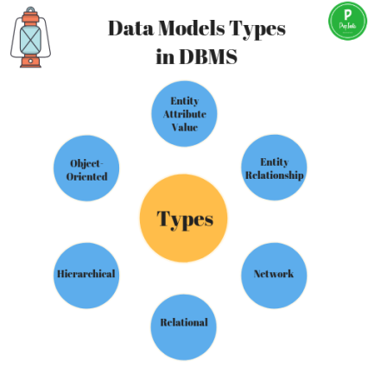
types of data models
There are many kinds of data models:
File based model
Entity-relationship model
Relational model
Hierarchical model
Network model
Object-Oriented model
Object-Relational model
Document model
Star schema
…

Slide 15
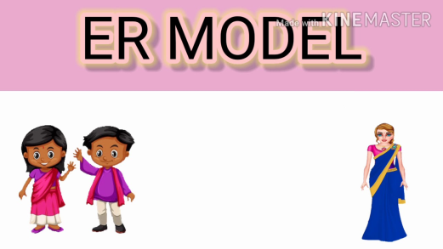
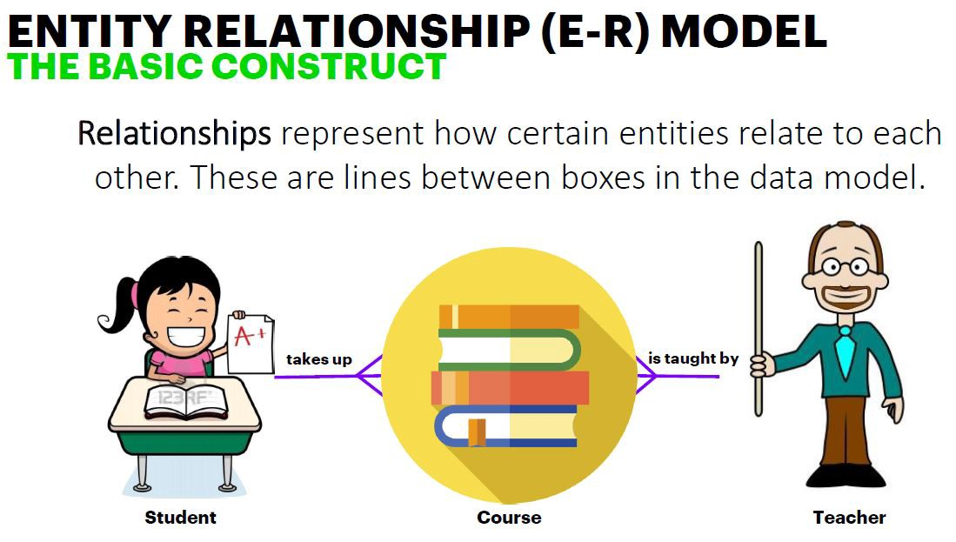
The e-r model
Designed by Peter Chen.
Entity-Relationship data model views the real world as a set of basic objects (entities) and relationships among these objects.
An E-R model describes the structure of a database with the help of a diagram, which is known as Entity Relationship Diagram (E-R Diagram).
An E-R model is a design or blueprint of a database that can later be implemented as a database.
Notes:
ER Diagram in DBMS is widely used to describe the conceptual and logical design of databases. It helps both users and database developers to preview the structure of the database before implementing the database.

Slide 16
basic concepts
The ER model defines the three most relevant steps. It works around real-world entities and the associations among them. At view level, the ER model is considered a good option for designing databases.
● Requirement Analysis ● Conceptual Database Design ● Logical Database Design
Requirement Analysis:
The very first step in designing a database application is to understand what data is to be stored in the database, what applications must be built on the top of it, and what operations the users want from the database.

Slide 17

basic concepts
Conceptual Database Design:
The information gathered in the requirements analysis step is used to develop a high-level description of the data to be stored in database, along with the constraints known to hold over the data. The ER model is one of the high-level or semantic, data models used in database.
Logical Database Design:
We must choose a DBMS to implement our database design, and convert the conceptual database design into a database schema in the data model of chosen DBMS. Sometimes conceptual schema is called logical schema in Relational Data Model.

Slide 18

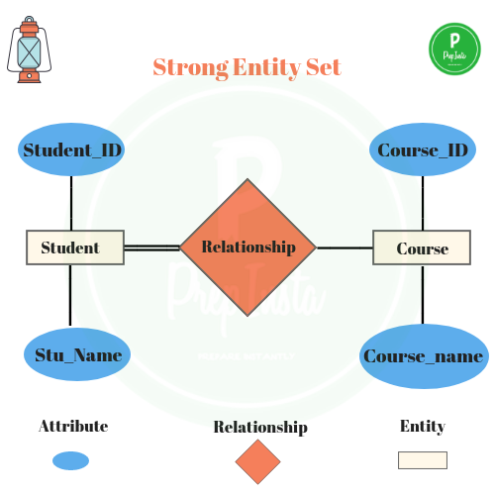
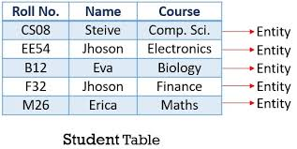
Entities and
entity sets
An entity is a tangible or non-tangible object that exists and is distinguishable from other objects and about which we can store information.
Example: person, company,
event, plant, account,…
Entities have attributes Example: people have names and addresses
An entity set is a set of entities of the same type that share the same properties.  Example: set of all persons, companies, trees, holidays
Notes:
An entity can be a real-world object, either animate or inanimate, that can be easily identifiable. For example, in a school database, students, teachers, classes, and courses offered can be considered as entities. All these entities have some attributes or properties that give them their identity.
An entity set is a collection of similar types of entities. An entity set may contain entities with attribute sharing similar values. For example, a Students set may contain all the students of a school; likewise a Teachers set may contain all the teachers of a school from all faculties. Entity sets need not be disjoint.

Slide 19
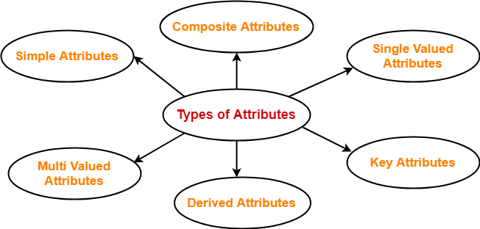
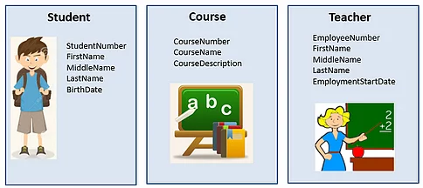
attributes
An entity is represented by a set of attributes, that is descriptive properties possessed by all members of an entity set.
Domain – the set of permitted values for each attribute
Attribute types:
Simple and composite attributes (Studentnumber / Name (FN,MN,LN))
Single-valued and multivalued attributes (Passportno / Phoneno)
Derived attributes (Age from birthdate)
Notes:
● Simple attribute - Simple attributes are atomic values, which cannot be divided further. For example, a student's phone number is an atomic value of 10 digits. ● Composite attribute - Composite attributes are made of more than one simple attribute. For example, a student's complete name may have first_name and last_name. ● Derived attribute - Derived attributes are the attributes that do not exist in the physical database, but their values are derived from other attributes present in the database. For example, average_salary in a department should not be saved directly in the database, instead it can be derived. For another example, age can be derived from data_of_birth. ● Single-value attribute - Single-value attributes contain single value. For example - Social_Security_Number. ● Multivalued attribute - Multivalued attributes may contain more than one values. For example, a person can have more than one phone number, email_address, etc.

Slide 20


keys
Key is an attribute or collection of attributes that uniquely identifies an entity among entity set. For example, the roll_number of a student makes him/her identifiable among students.
There are mainly three types of keys:
Super Key - A set of attributes (one or more) that collectively identifies an entity in an entity set.
Candidate Key - A minimal super key is called a candidate key. An entity set may have more than one candidate key.
Primary Key - A primary key is one of the candidate keys chosen by the database designer to uniquely identify the entity set.
Notes:
Continuous value not class
House value depending on area, no. of bedrooms, etc.

Slide 21

relationship
The association among entities is called a relationship. For example, an employee works_at a department, a student enrolls in a course. Here, Works_at and Enrolls are called relationships.
Relationship Set: A set of relationships of similar type is called a relationship set. Like entities, a relationship too can have attributes. These attributes are called descriptive attributes.
Degree of Relationship: The number of participating entities in a relationship defines the degree of the relationship.
Binary = degree 2
Ternary = degree 3
n-ary = degree n

Slide 22

Mapping cardinality
1-to-1
1-to Many
Many-to-1
Many-to-Many
Types of Relationships (Mapping Cardinality / Key Constraints)
One-to-one relationship (1:1): One instance in an entity (parent) refers to one and only one instance in the related entity (child).
One-to-many relationship (1:M): One instance in an entity (parent) refers to one or more instances in the related entity (child)
Many-to-one relationship (M:1): One or more instances in an entity (parent) refers to one instance in the related entity (child)
Many-to-many relationship (M:M): One or more instances in an entity (parent) refers to one or more instances in the related entity (child)

Slide 23
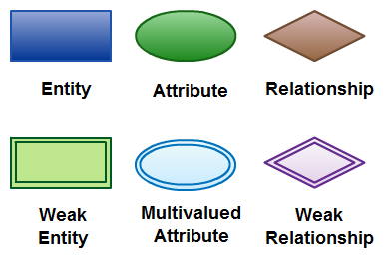
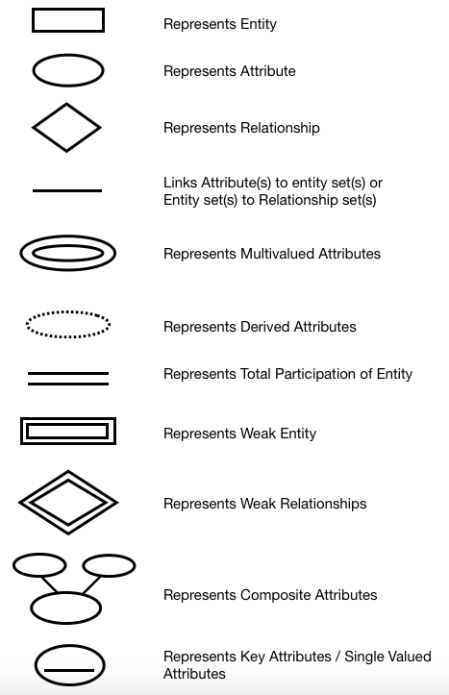
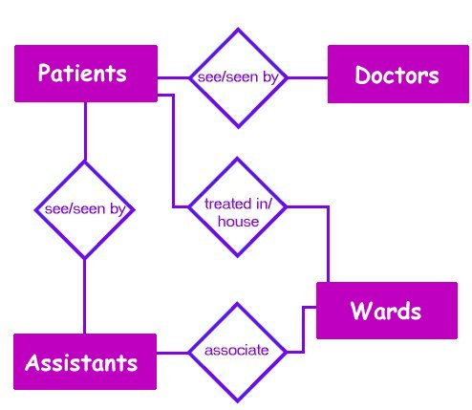
E-r diagram
Entity names: Nouns
Relationship names: Verbs

Slide 24

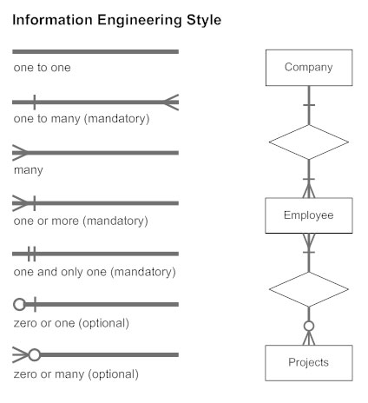
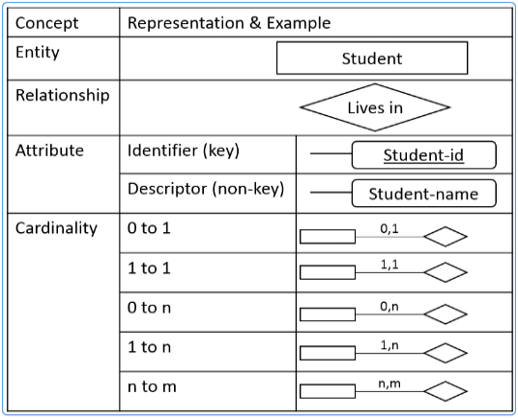
Key constraints

Slide 25

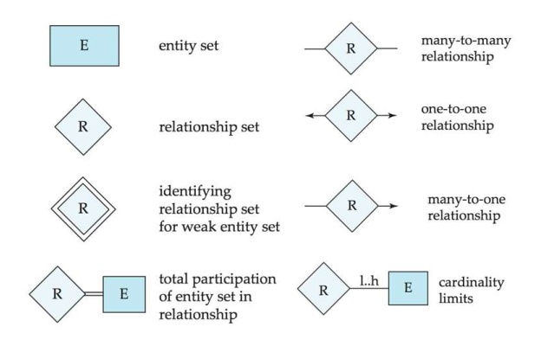
Key constraints
Other popular symbols:

Slide 26

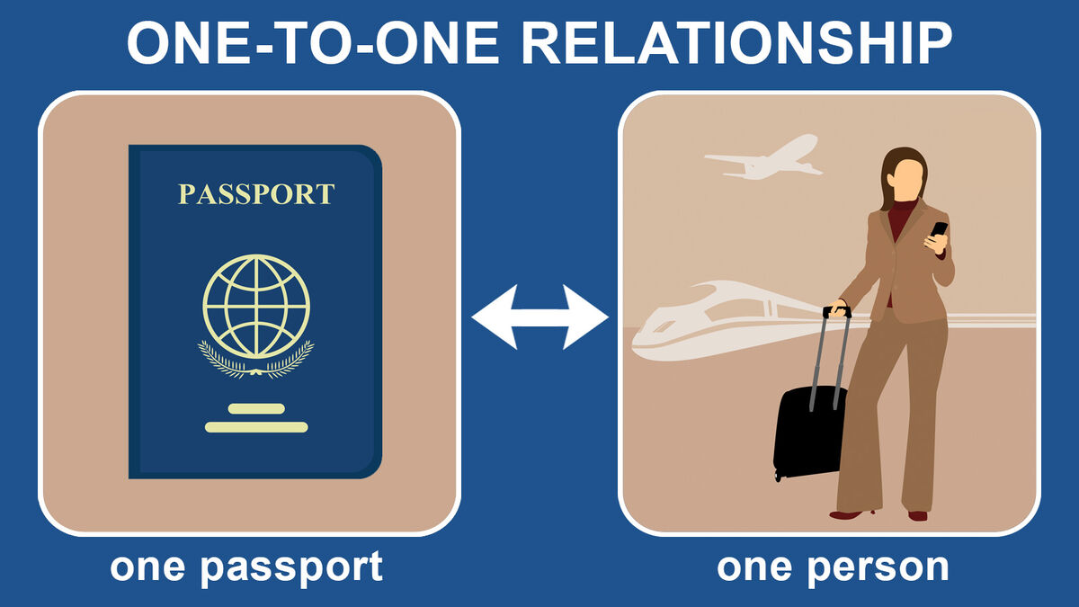
Key constraints
One-to-one: An entity in A is associated with at most one entity in B, and an entity in B is associated with at most one entity in A.
empno
pno
EMP
has
Passport

Slide 27









Key constraints
One-to-many: An entity in A is associated with any number in B. An entity in B is associated with at most one entity in A.
A woman from a club may be the mother of many (or no) children. A person may have at most one mother e.g. from set of women registered in a club and set of children in a playgroup
name
name
Is
Mother
of
Women's Club
Playgroup
Note that this example is not saying that Moe does not have a mother, since we know as a biological fact that everyone has a mother.
It is simply the case that Moe’s mom is not a member of the Women’s club.
Is mother of

Slide 28






Key constraints
Many-to-one: An entity in A is associated with at most one entity in B. An entity in B is associated with any number in A.
Many people are be born in one county, but any individual is born in at most one country e.g. an entity set of people registered in a Bowling Club and an entity set of countries.
name
Capital
Was
Born
in
Bowling Club
Country
Note that we are not saying that the Sea Captain was not born in some country, he almost certainly was, we just don’t know which country, or it is not in our Country entity set.
Also note that we are not saying that no one was born in Ireland, it is just that no one in the Bowling Club was.
Was born in

Slide 29

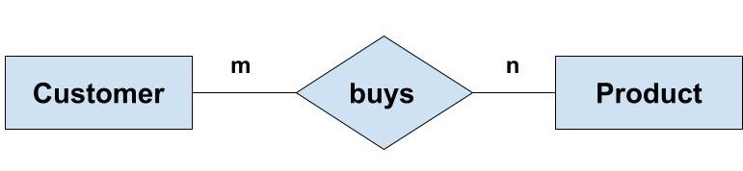
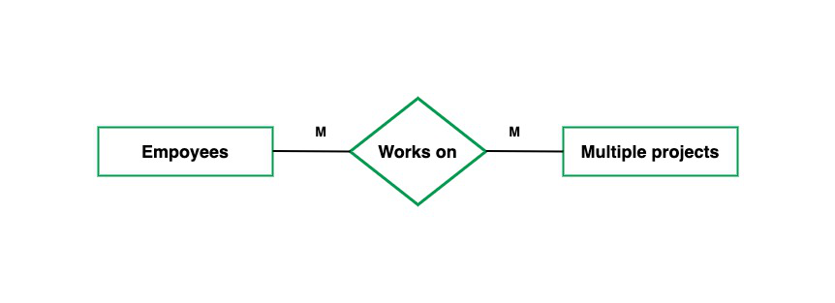
Key constraints
Many-to-many: Entities in A and B are associated with any number from each other.
Notes:
How Can Outlier Detection Improve Business Analysis?
Outlier data points can represent either a) items that are so far outside the norm that they need not be considered or b) the illustration of a very unique and singular category or variable that is worth exploring either to capitalize on a niche or find an area where an organization can offer a unique focus.
When considering the use of Outlier analysis, a business should first think about why they want to find the outliers and what they will do with that data. That focus will help the business to select the right method of analysis, graphing or plotting to reveal the results they need to see and understand.
When considering the use of Outlier analysis, it is important to recognize that, when the Outlier analysis is applied to certain datasets, the results will indicate that outliers should be discounted, while in other cases, the outlier results will indicate that the organization should focus solely on those outliers. For example, if an outlier indicates a risk or a mistake, that outlier should be identified and the risk or mistake should be addressed. If an outlier indicates an exceptional result, such as a person that recovered from a particular disease in spite of the fact that most other patients did not survive, the organization will want to perform further analysis on the outlier result to identify the unique aspects that may be responsible for the patient’s recovery.
When a business uses Outlier analysis, it is important to test the results and analyze the overall dataset and environment to be sure that the presence of outliers does not indicate that the dataset may be more complex than anticipated and may require a different form of analysis.

Slide 30

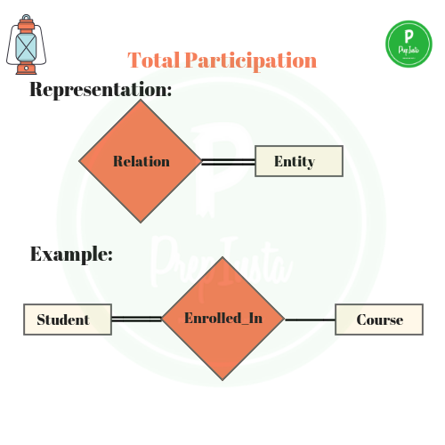

Participation constraints
Total Participation means each entity is involved in the relationship.
Partial participation means not all entities are involved in the relationship.
Total participation is shown in the form of bold line or double lines. Partial participation is represented by single lines.

Slide 31

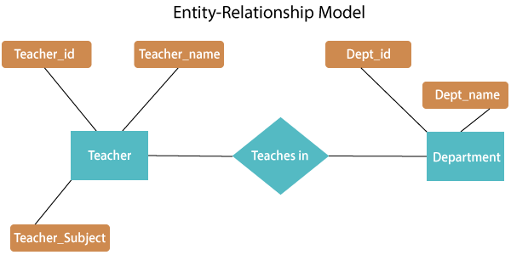
E-r diagrams
M
1
dept_id(FK)
Notes:
Add a definition/description of “traditional data analysis”.

Slide 32

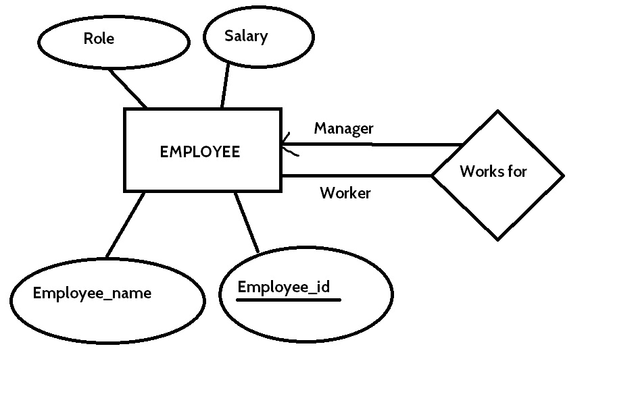

Unary relation
A student taking a course could be
a novice or expert.
A unary relationship is when both
participants in the relationship are
the same entity.
For Example: A team member is a supervisor for other team members.
Two connections with relation.
Course #
Expert
Study
Partner
Students
Novice
name
Notes:
Add a definition/description of “traditional data analysis”.

Slide 33

Multiple relations
Draw an E-R diagram to depict details about students studying/taking different courses and some students getting scholarship on some of the courses.
In each case there are a set of their own attributes.
There can be more than one relationship between entities.
takes
Student
Course
g
gets_sch
Notes:
Add a definition/description of “traditional data analysis”.

Slide 34
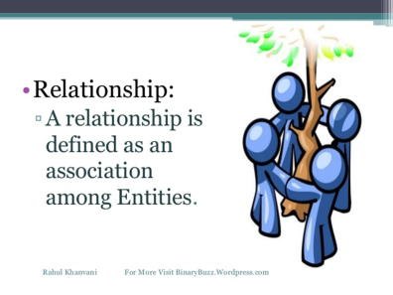
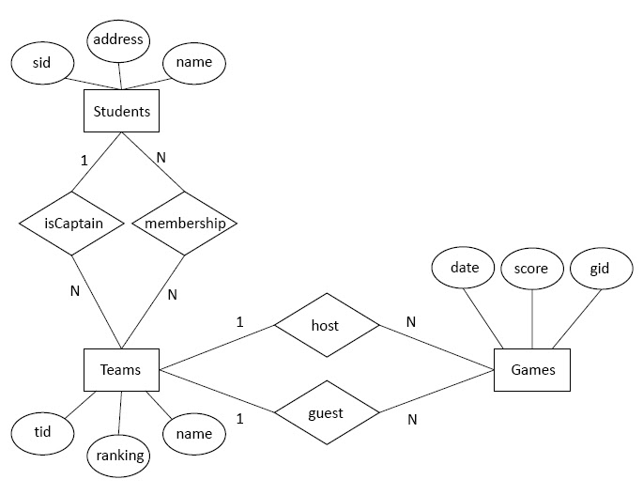
Multiple relations
ER diagram to depict students who are members of Teams and some students are captains.
Each have their own attributes and that is why separate relationships.
The teams can be the hosting teams or the guest teams.
Notes:
Add a definition/description of “traditional data analysis”.
One student can be part of multiple teams – cricket, basketball, etc.
One student can be captain of more than one team
Every team has only one captain

Slide 35
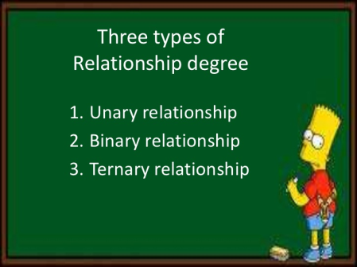
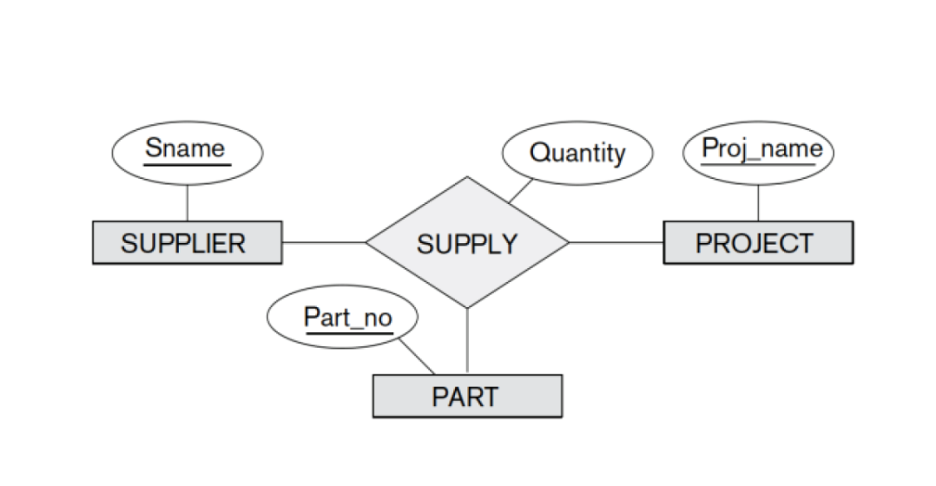

Ternary relations
Draw an E-R diagram for an application which stores details about parts being supplied to different projects by different suppliers.
A ternary relationship is when three entities participate in the relationship.
In general, unless you really need a ternary relationship, use binary relationships.

Slide 36
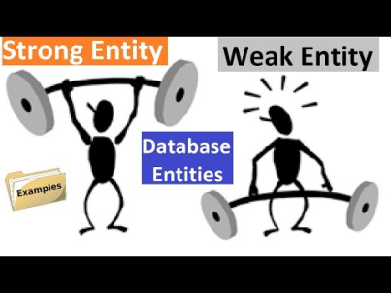
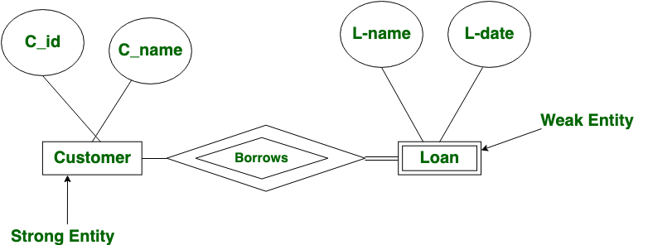
Weak entities
An entity type which is dependent totally on another entity set is called Weak Entity type.
The entity sets which do not have sufficient attributes to form a primary key are known as weak entity sets and the entity sets which have a primary key are known as strong entity sets.
The weak entities have total participation constraint (existence dependency) in its identifying relationship with owner identity.
Primary key of Loan is C_id+L_name (L_name is called discriminator)
-----

Slide 37

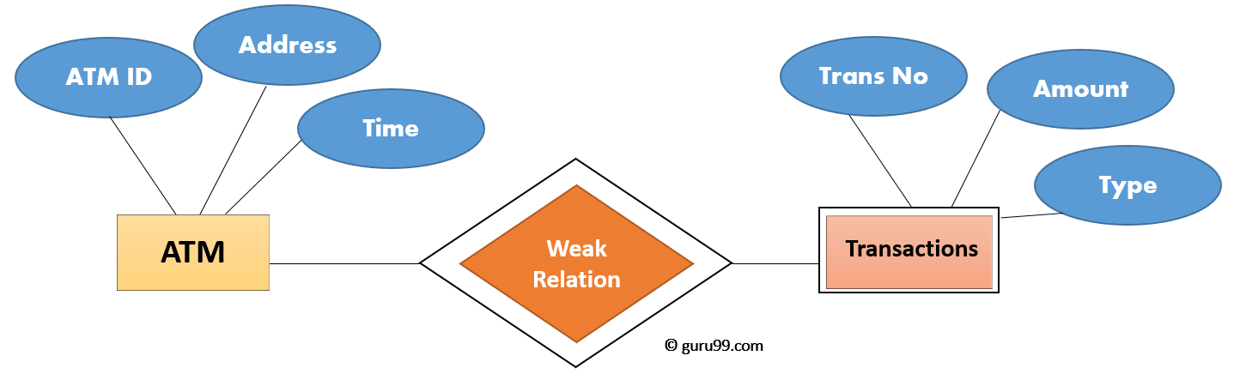
Weak entities
C_id | L_name | L-date
1112 | L123 | 12/10/2007
1112 | L889 | 10/03/2010
… | … | …
1323 | L889 | 25/12/2012
--------

Slide 38
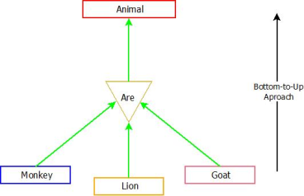
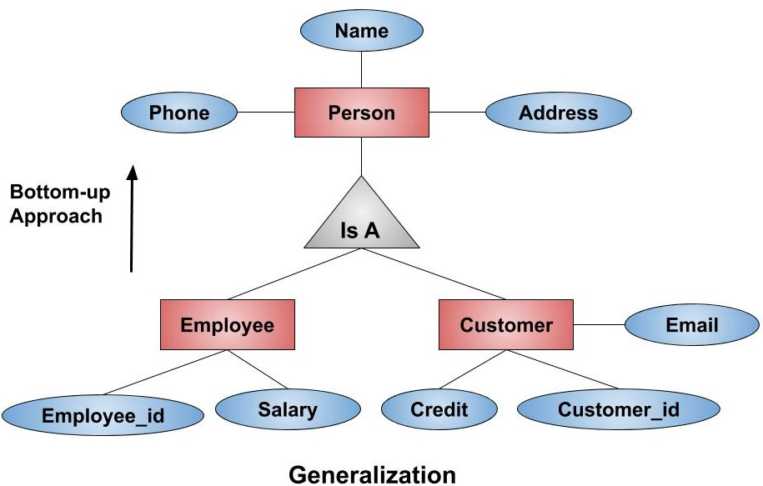
Extended e-r model
Generalization, Specialization and Aggregation in ER model are used for data abstraction in which abstraction mechanism is used to hide details of a set of objects.
Generalization is like a bottom-up approach in which two or more entities of lower level combine to form a higher level entity if they have some attributes in common.
In generalization, entities are combined to form a more generalized entity, i.e., subclasses are combined to make a superclass. It is a bottom-up approach.
Id
Notes:
Abstraction is the method of hiding the unwanted information. Whereas encapsulation is a method to hide the data in a single entity or unit along with a method to protect information from outside.
Encapsulation means hiding the internal details or mechanics of how an object does something. Abstraction is outer layout in terms of design. For Example: - Outer Look of a iPhone, like it has a display screen. Encapsulation is inner layout in terms of implementation.

Slide 39

E-R to tables (IS-A)
Two Options:
Option 1(Three tables)
The Employee and Customer table inherit the related id from Person table.
Person (id, name, phone, address)
Employee(employee_id,salary)
Customer(cust_id, credit, email)
Option 2 (Two tables)
The Employee and Customer table inherit all the related columns from Person table.
Employee(emp_id, name, phone, address, salary)
Customer(customer_id, name, phone, address, credit, email)
Id
Person table stores details about the
Employees as well as Customers.
(e.g. employee_ids start with ‘E’ and customer_ids start with ‘C’)

Slide 40
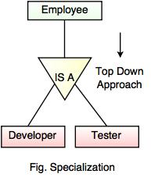
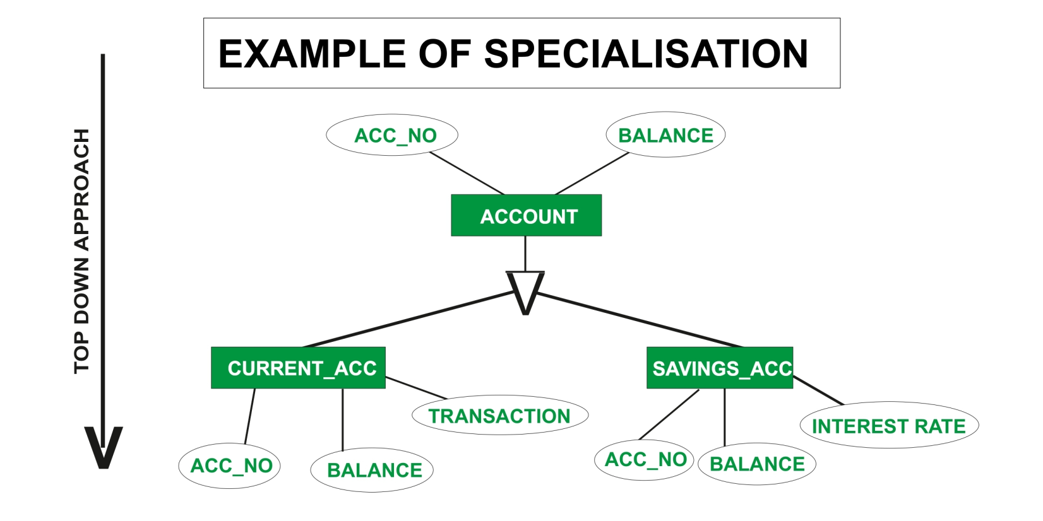
Extended e-r model
Specialization is a process of identifying subsets of an entity that shares different characteristics.
It breaks an entity into multiple entities from higher level (super class) to lower level (sub class). It is a top-down approach where higher level entity is specialized into two or more lower level entities.

Slide 41
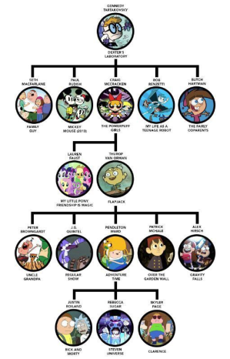
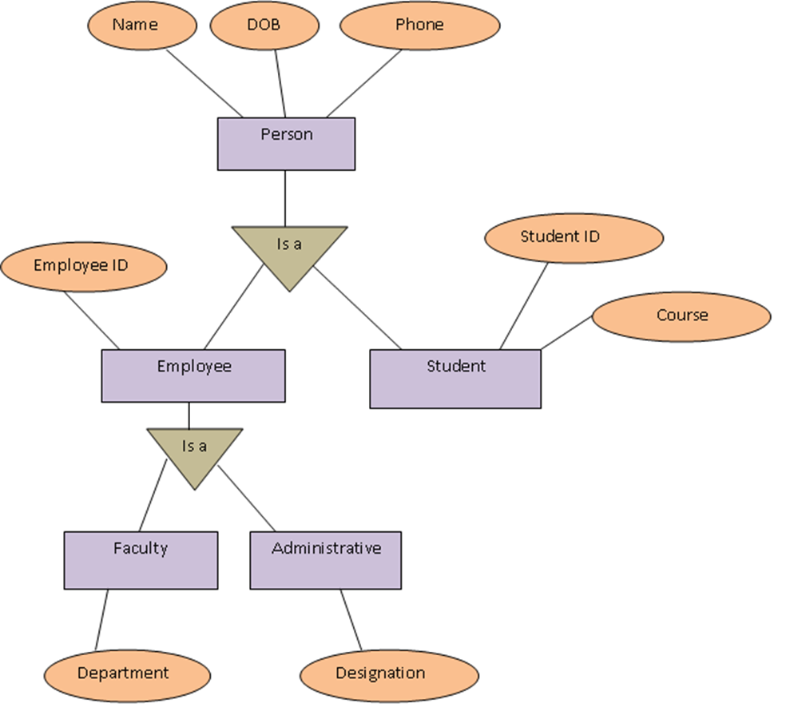
A lattice
Id
Notes:
Minimum 3 tables and maximum 5 tables

Slide 42
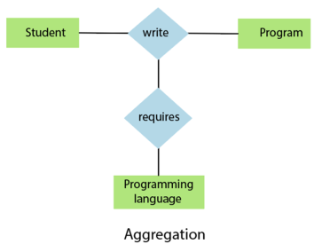
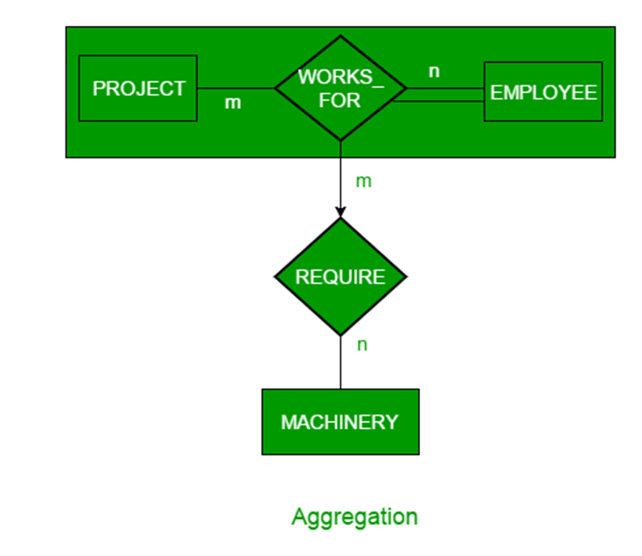
aggregation
Draw an E-R diagram to depict details about employees working on number of projects and while they work the details of the machinery that they use.
Using aggregation we can express relationship among relationships.
Aggregation shows 'has-a' or 'is-part-of' relationship between entities where one represents the 'whole' and other 'part'.
The primary key of REQUIRE would be the combination of primary keys of all three entities.
WORK

Slide 43
aggregation
Draw an E-R diagram to depict details about employees working on number of projects and while they work the details of the machinery that they use.
PROJECT
WORKS_
FOR
EMPLOYEE
REQUIRE
MACHINERY

Slide 44
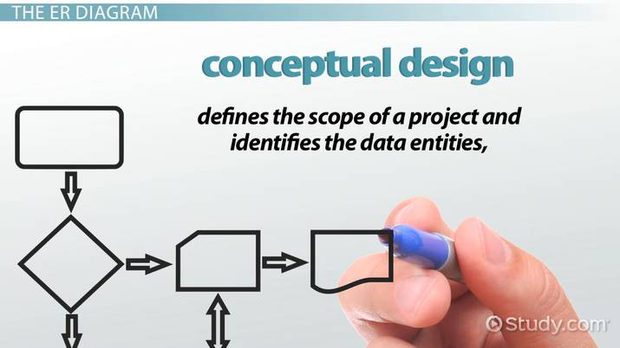
E-r design decisions
The use of an attribute or entity set to represent an object.
Whether a real-world concept is best expressed by an entity set or a relationship set.
The use of a ternary relationship versus a pair of binary relationships.
The use of a strong or weak entity set.
The use of aggregation – can treat the aggregate entity set as a single unit without concern for the details of its internal structure.

Slide 45



Entity vs. Attribute
Should address be an attribute of Employees or an entity connected to Employees by a relationship?
Depends upon the use we want to make of address information, and the semantics of the data:
If we have several addresses per employee, address must be an entity.
If the structure (city, street, etc.) is important, e.g., we want to retrieve employees in a given city, address must be modeled as an entity (since attribute values are atomic).

Slide 46


Entity vs. relati0nship
ER diagram is ok if a manager gets a separate discretionary budget for each dept.
What if a manager gets a common budget that covers all the managed depts? (Manages2 relation is for the manager)
Tables:
manages2(did, ssn, since, dbudget)
d1, 111, , 100000
d2, 111, , 100000
d3, 123, , 250000

Slide 47

Entity vs. relati0nship
What if a manager gets a common budget that covers all the managed depts? (Manages2 relation is for the manager)
Redundancy: dbudget stored for each dept managed by manager.
Misleading: Suggests dbudget associated with department-mgr combination.

Slide 48


E-R to tables (strong)
Converting Strong entity types:
Each entity type becomes a table (Person)
Each single-valued attribute becomes a column (SSN, Address, Birthdate)
Derived attributes are ignored (Age)
Composite attributes are represented by components (First, Last)
Multi-valued attributes are represented by a separate table (Hobbies)
The key attribute of the entity type becomes the primary key of the table (SSN)
Person
SSN | Fname | Lname | Address | Birthdate
111 | Bill | Clinton | LA | 12/12/64
112 | Angelina | Jolie | NY | 06/10/68
…
Hobby
SSN | Hobby
111 | Reading
111 | Hiking
112 | cooking
SSN – Fk to Person
SSN+Hobby – Pk

Slide 49

E-R to tables (weak)
Converting weak entity types:
Weak entity types are converted into a table of their own, with the primary key of the strong entity acting as a foreign key in the table.
This foreign key along with the discriminator of the weak entity form the composite primary key of this table
Payment_number is the discriminator.
Officer
Amt
Loan_number | Name | Amount
111 | Bill | 100000
112 | Angelina | 350000
…
Payment
Loan_number | Payment_number | Date | Amt
111 | 1 | 1/1/20 | 1500
111 | 2 | 1/2/20 | 1500
112 | 1 | 5/6/21 | 500
112 | 2 | 7/7/21 | 500

Slide 50



E-R to tables (relationships)
Converting relationships:
The way relationships are represented depends on the cardinality and the degree of the relationship
The possible cardinalities are:
1:1
1:M / M:1
N:M
The degrees are:
Unary
Binary
Ternary

Slide 51
E-R to tables (relationships)
EMPLOYEE
1
MANAGES
1
DEPT
M
1
WORKS_IN
FK
DeptCode

Slide 52




E-R to tables (1:1)

Slide 53



E-R to tables (1:N)

Slide 54



E-R to tables (M:N)
A new table is created to represent the relation
Contains two FKs
PK is the combination of both i.e.
StudentID CourseID

Slide 55


Self referencing

Slide 56



Self referencing (1:1)

Slide 57



Self referencing (1:N)

Slide 58




Self-referencing M:N
M
Subject
Has_pre
requisite
N

Slide 59



Ternary relations

Slide 60

examples
Draw an E-R Diagram to depict employees working in different departments. Some employees are managers of the departments. Every department handles a number of projects. One employee can work on more than one project. An employee can have zero or more dependents.
Entities:
DEPT
EMP
PROJECT
DEPENDENT
Relationships:
EMP – DEPT (M:1)
EMP – DEPT (1:1) – for manager of department
DEPT – PROJ (1:M)
EMP – PROJ (M:N)
EMP – DEPENDENT (1:M)

Slide 61

examples
Draw an E-R Diagram to depict employees working in different departments. Some employees are managers of the departments. Every department handles a number of projects. One employee can work on more than one project. An employee can have zero or more dependents.

Slide 62
examples
Draw an E-R Diagram to depict details about different departments of Faculty of Technology and Engineering. There are staff members and students in every department. Staff member can be Teaching or Administrative. Each have their own set of different information which needs to be stored. Passport details of staff members with all information is also to be maintained.
Draw an E-R Diagram for the CSE Departmental Library Management System. There are books, journals and DVDs in the library which can be issued. The members of the library are the staff and students. Currently every staff member can issue 6 books and keep them for 6 months. Every student can issue 2 books and keep them for 15 days. Include fine options for late return also.

Slide 63
examples
Draw an E-R Diagram for the CSE Departmental Library Management System. There are books, journals and DVDs in the library which can be issued. The members of the library are the staff and students. Currently every staff member can issue 6 books and keep them for 6 months. Every student can issue 2 books and keep them for 15 days. Include fine options for late return also.
Fine
M
pays
M
Item
M
M
Member
M
1
Type
issues
belongs
is a
is a
Book
Jour
DVD
Staff
Stud

Slide 64
Fine
M
pays
M
Item
M
issues
M
Member
M
belongs
1
Type
is a
is a
Book
Jour
DVD
Staff
Stud
TABLES:
item, book, journal. DVD
type(typeid, type_desc, no_books, no_days)
t1 staff 6 180
t2 student 2 5
member(mid, mname, …, typeid), staff, student
issues(issno, itemno, mid, dt_issue, dt_return, fine)
member(mid, mname, birth_dt, contact_no, typeid)
fine(days, amt)
pays(issno, itemno, mid, fine_amt)

Slide 65




examples
An E-R diagram with a ternary relation and an alternate Aggregation replacing the ternary relation.

Slide 66

End of E-R Model

